Slide 1
Matrix Inversion Capstone

Slide 2
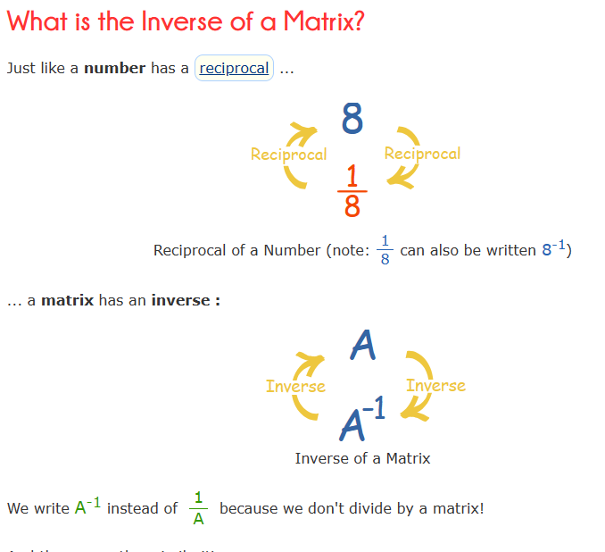
Matrix Inversion
Source: Inverse of a Matrix (mathsisfun.com)

Slide 3
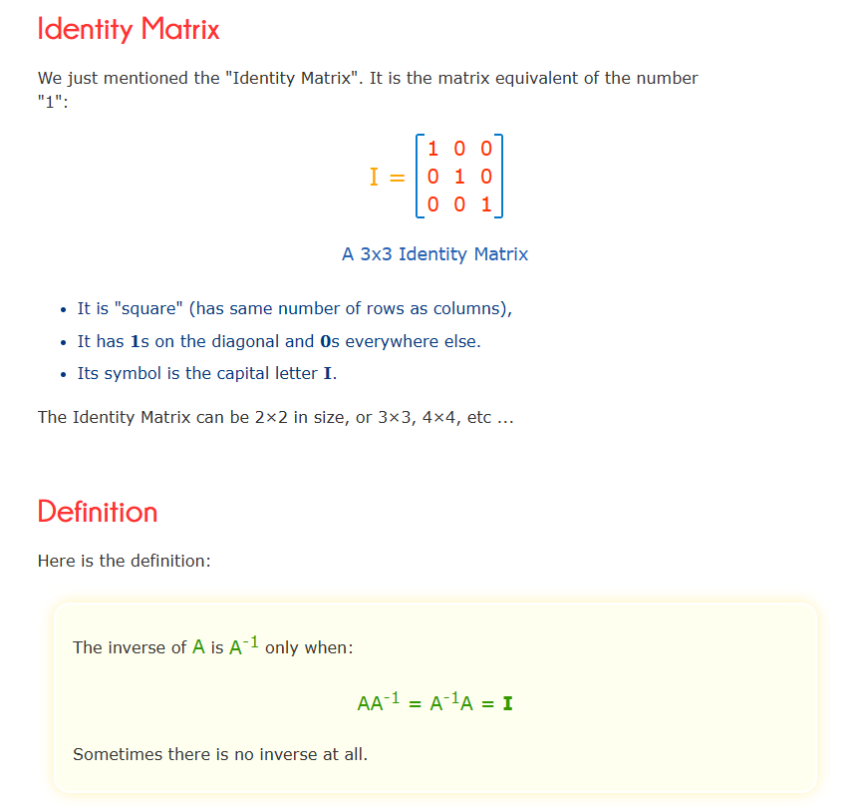
Source: Inverse of a Matrix (mathsisfun.com)

Slide 4
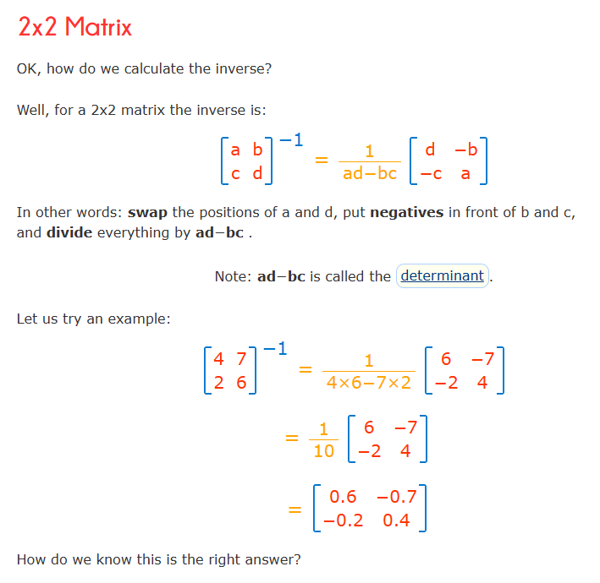
Source: Inverse of a Matrix (mathsisfun.com)

Slide 5
Sprint 1
Investigate linear regression, and decision tree classification between a matrix and its inverse for each matrix element
I will consider a 3x3 matrix with elements between 0 and 6 - not to simple but not overly complicated. This is a preliminary analysis - next sprint planning can be done to possibly test other matrices or go in a different direction entirely
Consider a linear regression with dependent variables being all elements of original matrix
Also consider all possible combinations of each element multiplied by another element in the matrix a00*a01, a00*a02, etc
By lucky mistake i also added the square of each element to the linear regression and found this as a way to increase value of a model
With further trial and error I found some better tests as well

Slide 6
Possible Impact of Sprint 1 results
Would be very interesting to see the r squared values for the various linear regressions - I will be considering the average r squared value of all inverse matrix entries
R-squared is a statistical measure of how well the linear regression model fits the data. It indicates the percentage of the variance in the dependent variable that is explained by the independent variables.
And see if there is an improvement when considering elements of the matrix multiplied by each other
Possibly find a linear regression to determine the inverse of a matrix

Slide 7
Applications of Matrix Inversion
There are a tremendous number of applications for matrix inversion. Back Propagation in neural nets is a major one. Other applications include:
Markov Chains: Matrix inversion is utilized in the study of Markov chains, a mathematical system that undergoes transitions between different states. The stationary distribution of a Markov chain can be found by solving a system of linear equations involving matrix inversion.
Optimization: In optimization problems, especially in linear programming, matrix inversion is employed to find optimal solutions. The inversion of matrices is often part of algorithms that iteratively improve solutions until an optimum is reached.
Control Systems: In control theory, matrix inversion is used to design controllers for dynamic systems. It plays a crucial role in determining the control law that stabilizes a system and achieves desired performance.
Computer Graphics: Matrix inversion is used in computer graphics to transform and manipulate 3D graphics. Techniques like affine transformations and perspective projection involve matrix operations, including inversion.
Image Processing: In image processing, matrix inversion is applied to techniques like image registration and geometric transformations. This is important in aligning and transforming images for further analysis.
Quantum Mechanics: Matrix inversion is frequently used in quantum mechanics, particularly in the representation of quantum states and the evolution of quantum systems.
Machine Learning: In machine learning, matrix inversion can be involved in certain algorithms, such as linear regression or certain optimization problems. However, due to computational considerations, alternative methods like gradient descent are often preferred.

Slide 8
Back Propagation
Neural Networks use matrix inversion as the calculation for the back propagation step.
There are many different algorithms for back propagation and there is a tremendous amount of research ongoing in this area.
I am investigating these algorithms and looking into data science investigations for improving algorithm efficiency.
This is becoming a more of a mathematical problem then a data science problem..When working with back propagation but I am not giving up.

Slide 9
Results of Sprint 1
Average R Squared values of the inverse matrix were very low. 0.06 was the highest result I could generate.
However I stumbled upon how the r squared value increased significantly when the square of each matrix element was added to the linear regression.
This got me thinking and i thought about squaring each element before multiplying it by every other element in the matrix, along with the cube of itself. This also significantly increased the r squared value.
This could have very well been an occurrence for the generated set of matrices, so I tried with 6 different sets and this pattern remained.
I really like this result and look forward to using it in the next sprints.

Slide 10
Overview of tests and results
Test 1: linear regression between matrix elements and inverse matrix elements
Test 2: linear regression with test 1 and all possible combinations of one matrix element multiplied by every other matrix element
Test 3: linear regression with test 2 and the square of each matrix element
Test 4: linear regression with test 1 and all possible combinations of one matrix element squared and multiplied by every other matrix element and the cube of each matrix element
Note how Test 4 does not even the parts of test 3 that included all possible combinations of one matrix element multiplied by every other matrix element - these are the tests I am reporting to demonstrate the importance of the aspect of test 4

Slide 11
Results
Average R Squared values for the Inverse Matrix entries
 | Random Seed 1 | Random Seed 2 | Random Seed 3 | Random Seed 4 | Random Seed 5 | Random Seed 6 | Random Seed 7
Test 1 | 0.001 | 0.0035 | 0.0025 | 0.004 | 0.0022 | 0.0026 | 0.0034
Test 2 | 0.0035 | 0.024 | 0.012 | 0.029 | 0.0088 | 0.014 | 0.02
Test 3 | 0.0047 | 0.026 | 0.015 | 0.034 | 0.011 | 0.017 | 0.024
Test 4 | 0.0087 | 0.04 | 0.024 | 0.06 | 0.017 | 0.027 | 0.037
It is very clear that each following test always increases the r squared value and that test 4 is the best always bettering test three by at least a third of test 4. These results clearly show the importance of test 4 along with the increasing importance of each test

Slide 12
Results
To recap, the first result is that adding each matrix element multiplied by every other matrix element to simply a regression of a matrix and its inverse increases the r squared value.
Adding the square of each matrix element to the regression increases the r squared value.
Using the square of each element further multiplied by every other matrix element, along with the cube of each matrix element increases the r squared value to a level higher then other tests

Slide 13
Sprint 2
I considered many different combinations of different size matrices and larger or smaller integer values, and floating point values and hermitian matrices. I will display results for the following tests:
-the same linear regression test from Sprint 1 but with integers from 0-10 and 10000 matrices
-the same linear regression test from Sprint 1 but with integers from 0-20 and 10000 matrices
-the same linear regression test from Sprint 1 but with random floats between 0.5 and 1.9 from and 10000 matrices
-the same linear regression test from Sprint 1 but with a 3x3 hermitian matrix with values between 0.0 and 1.0

Slide 14
Sprint 2 results - R Squared values
 | Test 1 | Test 2 | Test 3 | Test 4
Case 1 | 0.0005 | 0.0009 | 0.0005 | 0.0003
Case 2 | 0.002 | 0.0024 | 0.002 | 0.001
Case 3 | 0.003 | 0.007 | 0.003 | 0.002
Case 4 | 0.0055 | 0.011 | 0.005 | 0.003
No new results from sprint 1. We see an increase in r squared values throughout the cases as we did with cases from sprint 1. The Hermitian matrix had the same results as non hermitian matrices.

Slide 15
Sprint 3 - Part 1
-Use a TensorFlow Neural Network to attempt to find a model for Eigenvalues, Eigenvectors, sum of eigenvalues and sum of eigenvectors for hermitian and non hermitian matrices
-3x3 matrices with values 0-6 is a good starting point based on reduced complexity. I worked with 12000 randomly generated matrices as my test data
-I used the following model
# Create a new sequential model
model = keras.Sequential()
# Declare the hidden layers
model.add(layers.Dense(120, activation="relu"))
model.add(layers.Dense(120, activation="relu"))
model.add(layers.Dense(120, activation="relu"))
model.add(layers.Dense(60, activation="relu"))
model.add(layers.Dense(30, activation="relu"))
# Declare the output layer
model.add(layers.Dense(12, activation="linear"))
Av = λv
A is a matrix
v are the eigenvectors
Lamba are the eigenvalues

Slide 16
Sprint 3 - Part 1
An invertible matrix and its inverse have the same eigenvectors. Eigenvalues are related as per the previous slide. If a good tensorflow neural network can be found for eigenvalues and eigenvalues it would be a good step towards a machine learning solution for matrix inversion
Model results:
Hermitian matrix - eigenvectors: 0.024 - eigenvalues: 0.2148
Non Hermitian Matrix - eigenvectors: 0.026 - eigenvalues: 0.059
0.2148 for Hermitian Matrix eigenvalues is an interesting result but not suitable for a matrix inversion solution.

Slide 17
Sprint 3 - Part 1
Looking for further patterns with tensorflow I modelled sum of eigenvectors and eigenvalues for Hermitian and Non Hermitian Matrices
Hermitian Matrices - sum of eigenvectors: 0.0567 - sum of eigenvalues: 0.111
Non Hermitian Matrices - sum of eigenvectors: 0.0528 - sum of eigenvalues: 0.0397
It’s very interesting how sum of eigenvalues is less predictable for non hermitian matrices, clearly the sum of eigenvalues is more predictable with a neural network for hermitian/symmetric matrices. Unfortunately the model is not reliable enough for these metrics.

Slide 18
Sprint 3 - Part 2
The Inverse of a matrix can be quantified by the adjoint matrix and its determinant
Inv = Adj Matrix / Determinant
Adj Matrix = matrix of cofactors transposed
A cofactor matrix is a matrix that comprises the cofactors of each element in a matrix. A cofactor is a number obtained when the minor Mij of the element aij is multiplied by the (-1)i+j. i and j represent the row and column of the particular element whose cofactor is being determined.
Source: wikipedia

Slide 19
Sprint 3 - Part 2
I have some interesting results to share with linear regression to determine the adjoint matrix from a 3x3 matrix with integers between 0-6.
Using my analysis from Sprint 1, but seeking an adjoint instead of an inverse; remember an inverse is the adjoint divided by the determinant, I achieved an r squared value of 0.82 averaged across each cell of the adjoint using linear regression on cells of the original matrix

Slide 20
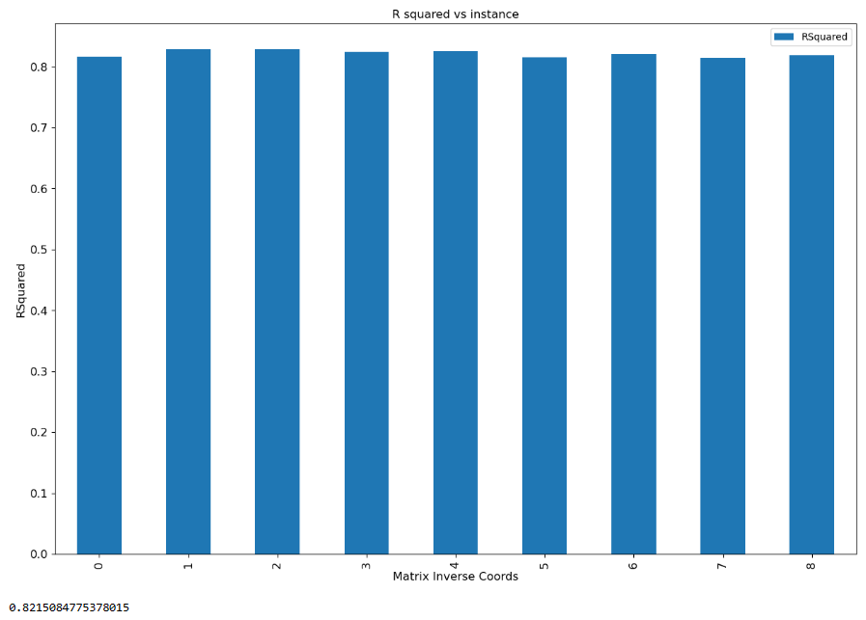
Slide 3 - Part 2

Slide 21
Sprint 3 - Part 2
The following were the tests I included in my sprint 1 report:
Test 1: linear regression between matrix elements and inverse matrix elements
Test 2: linear regression with test 1 and all possible combinations of one matrix element multiplied by every other matrix element
Test 3: linear regression with test 2 and the square of each matrix element
Test 4: linear regression with test 1 and all possible combinations of one matrix element squared and multiplied by every other matrix element and the cube of each matrix element
Each successive test provided a better model with different sets of matrices however the best r squared value achieved was 0.06. With Test 2 on adjoint matrices instead of inverses I found 1.0
That’s right, a perfect fit!

Slide 22
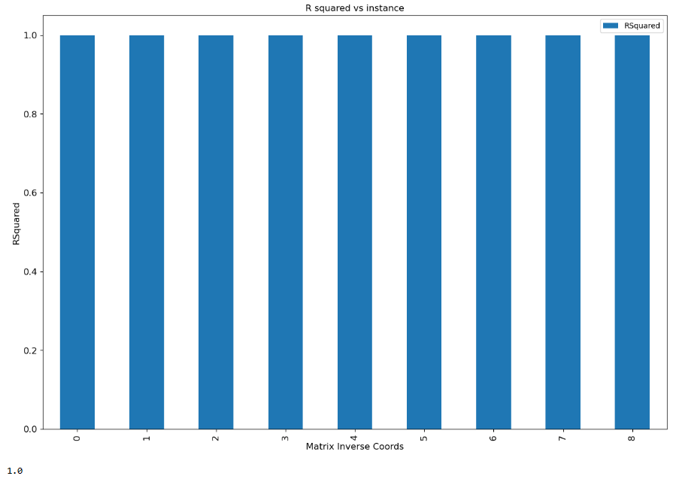
Slide 3 - Part 2

Slide 23
Sprint 3 - Part 2
What does this mean? The adjoint matrix of a 3x3 matrix for integers can be fit to a linear regression with terms of each matrix element multiplied by every other matrix element.
It is possible that this is the nature of the formula for the adjoint of a 3x3 matrix.
Further investigation is required to determine if this property works for larger matrices, as well as matrices that contain terms other than integers.
The model will need to be tested in numpy to see if it is faster then the current formula for calculating the adjoint of a 3x3 matrix.

Slide 24
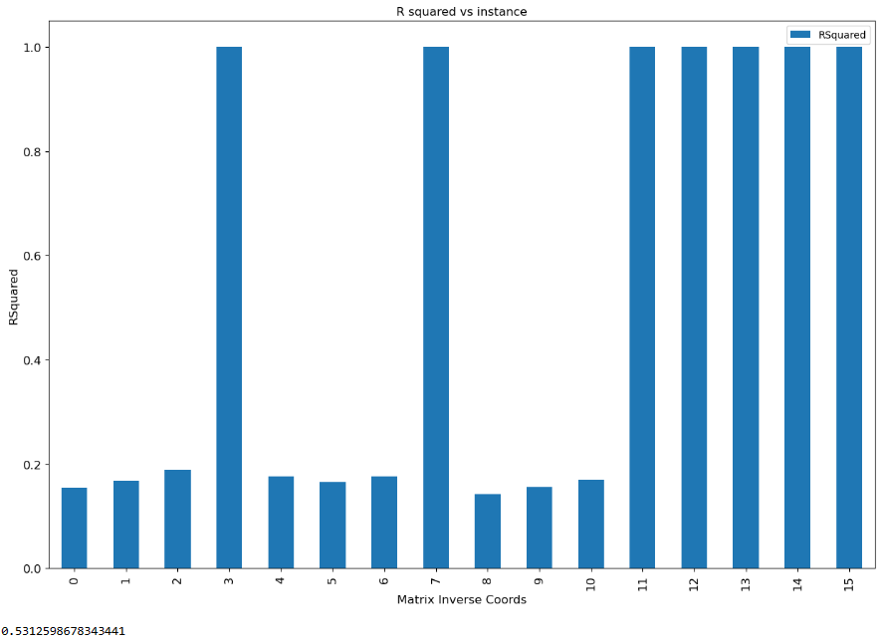
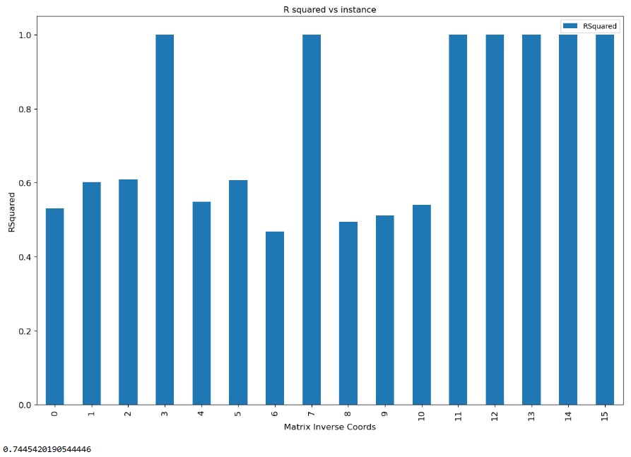
Slide 3 - Part 2
Some interesting results for a 4x4 matrix, some cells were able to match well, however other cells had different behavior

Slide 25
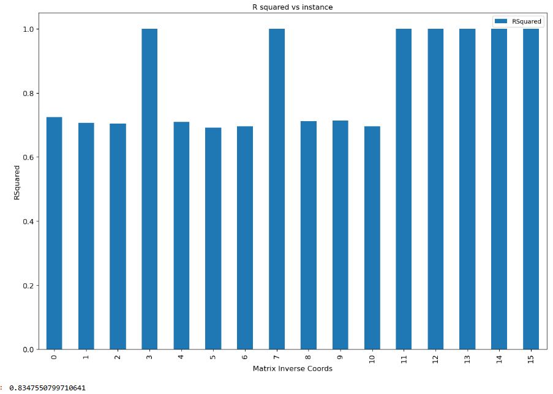
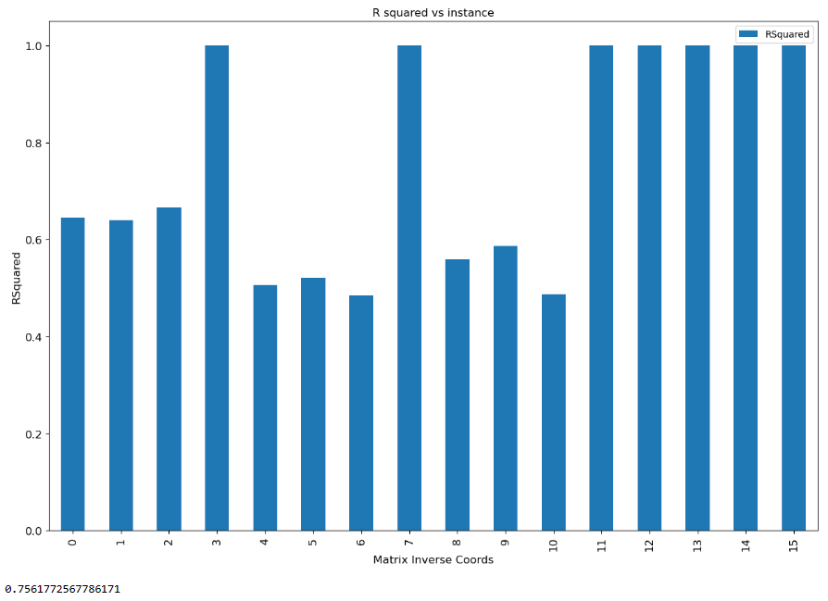
Sprint 3 - Part 2

Slide 26
Sprint 3 - Part 2
83% is the best r squared value achieved for 4x4 matrices. Test 3 is the best parameters which were. So clearly the good result for a 3x3 matrix is related to the formula for an adjoint for a 3x3 matrix. And not reproducible for larger matrices. Further investigation is required for larger 5x5 matrices and larger along with matrices with decimal instead of integer components.
Test 3: linear regression with each matrix element and all possible combinations of the square of each matrix element multiplied by every other matrix element
Why is this different from sprint 1, the inverse has now been specified as the adjoint divided by the determinant.
This is the determinant of a 3x3 matrix which is constant for each term so the key is the adjoint.

Slide 27
Conclusion
Lots has been learnt. From sprint 1 I learnt that the best linear regression for the inverse of a matrix is each matrix element squared multiplied by every other matrix element.
In Sprint 3 I came up with a neural network model to predict eigenvalues of a hermitian matrix with an accuracy of 21%. And an interesting result for adjoint matrices that requires further investigation However it is possible to reduce larger matrices to sets of 3x3 matrices so this could be a useful property. Google’s deep learning lab used sets of 2x2 matrices for a formula for larger matrices.
I will need to do more work to create a machine learning model for matrix inversion. I will work with more complex tensorflow models and try to create intermediate steps to create more parameters for the tensorflow to continue this project.
A lot of research by scientists and engineers is being done on formulas for matrix inversion, increasing the speed of this computation would be groundbreaking as currently non invertible matrices due to time complexity would become invertible, as well as invertible matrices could be inverted faster. This is definitely an area of research of great value. This began for me in 2004 with a geophysical modelling and my quest shall continue into the future.

